Slide 1

Medical Price Prediction Using Machine Learning​

Slide 2

Contents:
Problem Statement
Introduction
About The Data
Data Cleaning and Basic EDA
Data Preparation Steps
Data Splitting
Data Preparation Techniques
Model Building
Evaluation
Conclusion

Slide 3
Problem Statement
To predict the medical costs billed by health insurance based on individual features.

Slide 4
Introduction:
Insurance is a contract, represented by a policy, in which a policyholder receives financial protection or reimbursement against losses from an insurance company.It involves two parties : the insurer and the insured.
The insurer provides compensation for covered losses in exchange for premiums paid by the insured.
Importance of Health Insurance
Health insurance policy is an assurance which provides immediate financial help in case when any medical emergency arises.
Financial Protection : Health insurance covers or reimburses the expenses associate with medical treatments, thus protecting individuals from high healthcare costs.
Preventive Care : Many plans cover preventive services, encouraging early detection and treatment of diseases, which can reduce the severity of and cost of treatment.

Slide 5
Growth Drivers of Health Insurance in India
Increased Awareness : There is growing awareness among the Indian population about the benefits of health insurance , partly due to government initiatives and digitalisation like online platforms and apps making easier to comparison .
Government Initiatives : Government Schemes like Ayushman Bharat(Pradhan Mantri Jan Arogya Yojana) have played a significant role in increasing the penetration of health insurance.

Slide 6
About the Medical Cost Dataset Features of Data:
Age: The age of the primary beneficiary.
Sex: The gender of the insurance person.
BMI: Body Mass Index, an objective index of body weight categorizing individuals into underweight, normal weight, overweight based on the ratio of height to weight.
Children: The number of dependents.
Smoker: Indicates whether the beneficiary is a smoker (yes or no), significantly impacting health risks and associated costs.
Region: The beneficiary's residential area categorized into northeast, southeast, southwest, or northwest, potentially influencing healthcare costs due to regional differences in healthcare access and pricing.
Charges: The individual medical costs billed by health insurance, representing the target variable for prediction. This reflects the total expenses that the insurance company pays for the individual's healthcare services.

Slide 7
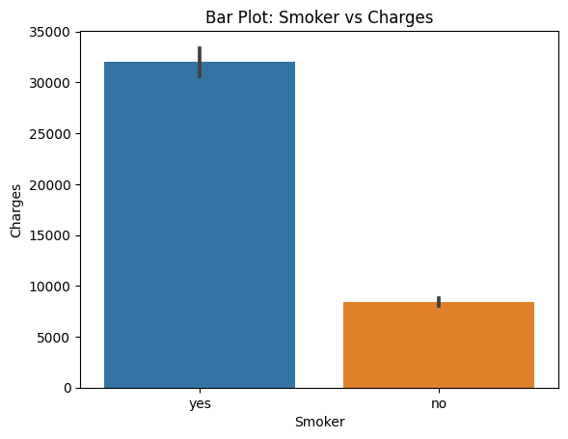
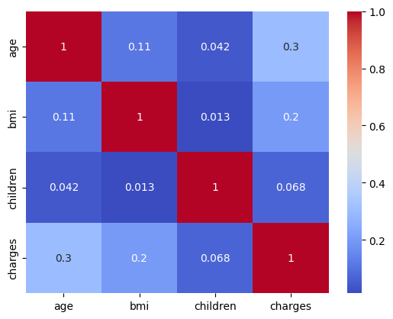
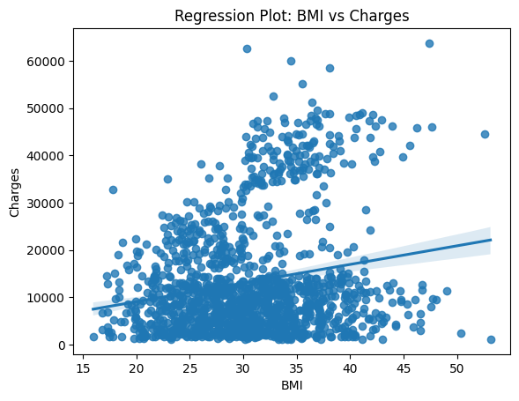
Data Cleaning And Basic EDA :
The basic EDA which I Performed
I have observed the smoker having more charges than a non smoker.
There is a weak relation ship between bmi, charges and age,charges.
The more distribution points of body mass index is 20 to some around 40 of charges 10000 to 20000.

Slide 8
Data Preparation Steps:
Input Variables (Features):
Age: Numerical.
Sex: Categorical.
BMI: Numerical.
Smoker: Categorical.
Region: Categorical.
Output Variable (Target):
Charges: Numerical.
The medical costs billed by health insurance for the individual, which we aim to predict.

Slide 9
ML Task : Regression
Why Regression?:
The goal is to predict a continuous quantity (medical costs).
Regression models are designed to predict numerical values based on input features, making it the appropriate machine learning task for this objective.

Slide 10
Data Splitting :
Train-test split is a common technique used in machine learning and data analysis. It involves splitting the available data into two separate sets: a training set and a testing set.
The training set is used to train the machine learning model or perform data analysis.
The testing set is used to evaluate the performance of the trained model or validate the analysis.
Randomness is important in the split to ensure a representative sample of the data in both sets

Slide 11
Data Preparation Techniques :
Numerical Variables: Handling the Scales
Standardization: Transforms features to have a mean of zero and a standard deviation of one.
When data features have different scales and when model algorithms assume normally distributed data (e.g., Linear Models).
Normalization: Adjusts values measured on different scales to a notionally common scale, often 0 to 1.
Categorical Variables: Making Categories Machine Readable
Label Encoding: Converts each value in a categorical column into a numerical value.
When the categorical variable is ordinal (there is a clear ordering of the categories)
One Hot Encoding: Creates a new binary column for each category level.

Slide 12
Model Building Algorithms:
1.K-Nearest Neighbors (KNN)
KNN is used for both classification and Regression Algorithm Technique . KNN is a lazy learner.
KNN is Instance-based learning, non-parametric. Predicts the label of a data point by looking at the 'k' closest labeled data points and taking a majority vote.
2.Linear Regression
Parametric. It is the relationship between a dependent variable and one or more independent variables by fitting a linear equation to observed. Predicting a continuous outcome variable where a linear relationship is assumed between input variables and the output.
3.Support Vector Machine
It is a classification and also used for regression - SVR. Finds the hyperplane that best separates different classes in the feature space by maximizing the margin between the closest points of the classes (support vectors).
4. Decision Trees
Tree-based model for classification and regression. Splits the data into subsets using feature values, making the decision based on the feature.
5.Random Forest
Ensemble of Decision Trees. It is used for both classification and regression tasks. Builds multiple decision trees and merges them together to get a more accurate and stable prediction.

Slide 13
Evaluation :
Evaluation Metric: Mean Absolute Error (MAE)
The Mean Absolute Error (MAE) measures the average absolute difference between the predicted values and the actual values.
MAE=(1/n)*Σ |y-y^|
A lower MAE indicates better performance, as it means the model is making more accurate predictions. When comparing different models, the one with the lowest MAE is generally considered to be the better-performing model.
The mean absolute errors of performed algorithms:
KNN- 9265.18
Linear Regression - 9181.55
SVM – 8475.75
Decision Tree – 10715.96
Random Forest - 9338.83

Slide 14
Conclusion:
The Support Vector Machine (SVM) algorithm has the lowest MAE, indicating better predictive performance on average.
Linear Regression also performs reasonably well.
Random Forest and K-Nearest Neighbors (KNN) have moderate MAE scores.
Decision Tree Classifier has the highest MAE among the models.
Based on the MAE scores, SVM appears to be the best-performing algorithm for medical cost prediction problem.

Slide 15


